Slide 1
The Best Neighborhood for your retirement life!!!
By Thomas Ching

Slide 2
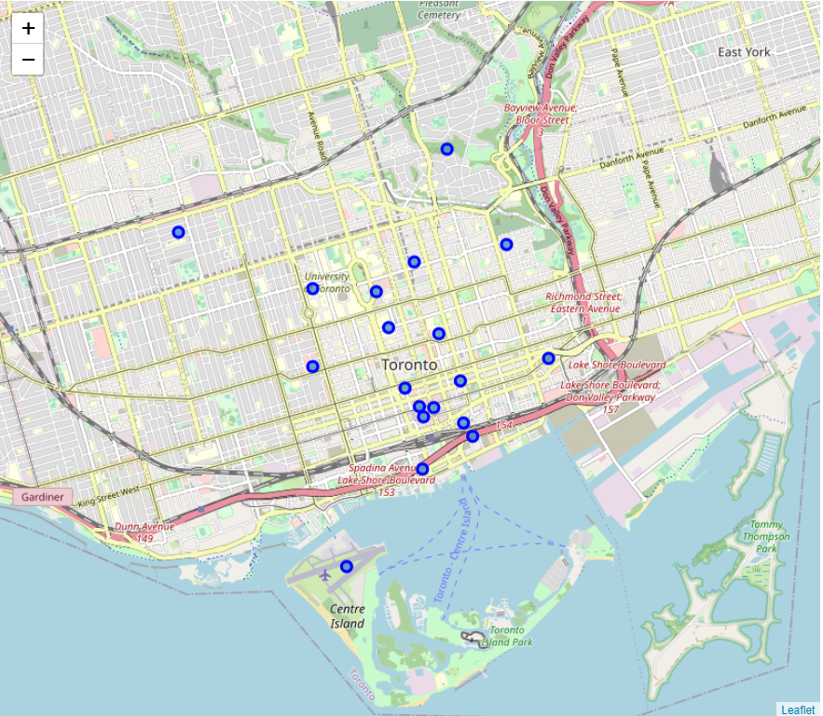
Where do you want to live for the rest of your life?
Toronto, Ontario, Canada
Ranked the best retirement community in Canada by Maclean’s, a Canada based news magazine, serving Canadian since 1905
Multi-cultural cities with vibes and energies which makes you feel young
Source: (https://www.macleans.ca/economy/best-communities-retire-canada-2019/)

Slide 3
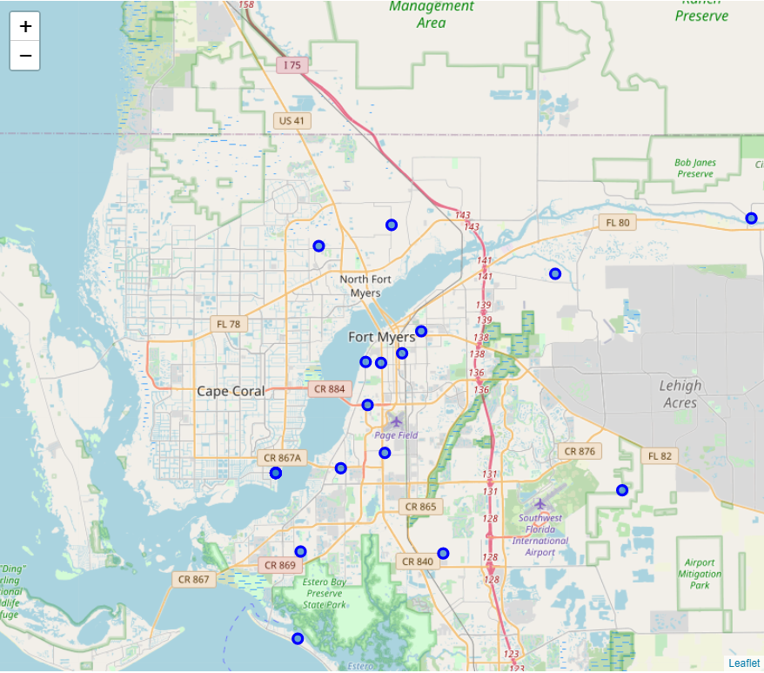
Where do you want to live for the rest of your life?
Fort Myers, Florida, USA
Picked as the best retirement community in the US by U.S. News & World Report, a U.S. based multi-platform publisher of news and information
Seaside city for relaxing and chilling
Source: (https://realestate.usnews.com/places/florida/fort-myers)

Slide 4
How am I going to pick it for you?
Neighborhood data:
Toronto: https://en.wikipedia.org/wiki/List_of_postal_codes_of_Canada:_M
Fort Myers: https://public.opendatasoft.com/explore/dataset/us-zip-code-latitude-and-longitude/table/
Scoring System based on the methodology used by Maclean’s (https://www.macleans.ca/economy/best-communities-in-canada-2019-methodology/)
Foursquare API
Full venue category list and applying filtering for retiree’s most concerning facilities and services
Search the venues around the neighborhoods and include only what we need

Slide 5
5 types of most concerned venues by retirees
Type 1: Health Care
Type 2: Transportation and Travel
Type 3: Government and Public Services
Type 4: Amenities
Type 5: Art, Culture and Community
Source: (https://www.macleans.ca/economy/best-communities-in-canada-2019-methodology/)

Slide 6
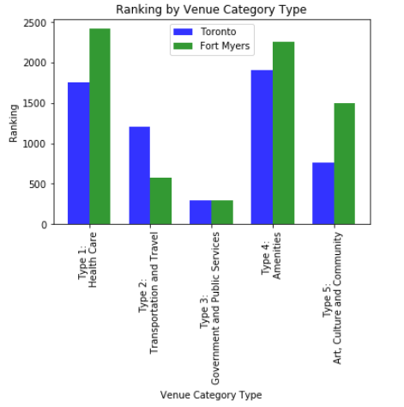
Data Visualization and Results
Both neighborhoods have their pros and cons
Fort Myers:
Health Care
Amenities
Art, Culture and Community
Toronto:
Transportation and Travel
The neighborhoods call a tie at Government and Public Services

Slide 7
Conclusion and future directions
Include more criterias for evaluating the best retirement place
Weather
Crime rate
Affordability of living
Tax rate
Build more comprehensive scoring model for incorporating the above 4 critierias into the analysis

